Slide 1
Human Computer Interaction
Evaluation Techniques
Chapter 9b
Imran Siddiqi
imran.siddiqi@mcs.edu.pk

Slide 2
Evaluation through User Participation
Actual User not designer or expert
Later stage of development
Evaluation Techniques

Slide 3
Styles of Evaluation
Lab Studies
  Users taken out of their normal work environment to take part in controlled test
  Lab could be just a “Quiet Room”
Field Studies
  Take evaluator to user’s work environment
Evaluation Techniques

Slide 4
Lab Studies
Advantages:
  Specialist equipment available – Audio Visual Recording etc.
  Uninterrupted environment
Disadvantages:
  Lack of context – Wall papers, cabinets, disturbances (Not close to reality)
  Difficult to observe several users cooperating
Appropriate
  If system location is dangerous or remote
  War environment and space station
Evaluation Techniques

Slide 5
Field Studies
Advantages:
  Natural environment
  Might observe interactions between system and individual that may be missed in a lab study
  Longitudinal studies possible Days or Months
Disadvantages:
  Distractions (Phones, visitors)
  Noise
Evaluation Techniques

Slide 6
Empirical Methods – Experimental Evaluation
Evaluating a design in controlled experiment
Evaluator chooses hypothesis to be tested
A number of experimental conditions are considered which differ only in the value of some controlled variable
Changes in behavioural measure are attributed to different conditions
Evaluation Techniques

Slide 7
Experimental Factors
Participants
  Who – representative, sufficient sample
Variables
  Things to modify and measure
Hypothesis
  What you’d like to show
Experimental design
  How you are going to do it
Evaluation Techniques

Slide 8
Participants
Participants should be chosen to match expected user population as close as possible
  Ideally end user but not always possible
  At least same age, educational background, experience, etc…
Similar expertise and domain knowledge
  Is a engineering background representative of general population?
Sample size
  Large sample size considered representative of population
Evaluation Techniques

Slide 9
Variables
Independent variable (IV)
  Characteristic changed to produce different conditions
  E.g. interface style, number of menu items, icon design
Dependent variable (DV)
  Characteristics that can be measured in the experiment
  Their value is dependent on changes made to Independent variables (IV)
  E.g. time taken to perform a task, number of errors etc;
Evaluation Techniques

Slide 10
Hypothesis
Prediction of outcome of an experiment
Aim of experiment is to show that this predictions are correct
  Framed in terms of IV and DV
  E.g. “error rate will increase as font size decreases”
Null hypothesis:
  States no difference between conditions
  Aim is to disprove this
  E.g. null hyp. = “no change with font size”
Evaluation Techniques

Slide 11
Experimental Design
First phase is to choose hypothesis
  What are you trying to prove
Clarify independent and dependent variables
Consider your participants
Choose experiment method
  Within- Subjects
  Between- Subjects
Evaluation Techniques

Slide 12
Experimental Design
Within subjects design
  Each subject performs experiment under each condition
  Transfer of learning possible
  Less costly and less likely to suffer from user variation
Between subjects design
  Each subject performs under only one condition
  No transfer of learning
  More users required
  Variation can bias results
Evaluation Techniques

Slide 13
Observational Methods
(Observe users interact with a system)
Think Aloud
Cooperative evaluation
Post-task walkthroughs
Evaluation Techniques

Slide 14

Think Aloud
User observed performing task
  User asked to describe what he is doing and why, what he thinks is happening etc.
Advantages
  Simplicity - requires little expertise
  Can provide useful insight
  Can show how system is actually use
Disadvantages
  Performance may not be natural in the presence of observer
  Act of describing may alter task performance
Evaluation Techniques

Slide 15
Cooperative Evaluation
Variation on think aloud
User collaborates in evaluation
Evaluator asks questions - “Why?” “What if?”
Additional advantages
  Less constrained and easier to use
  User is encouraged to criticize system
  Clarification possible
Evaluation Techniques

Slide 16

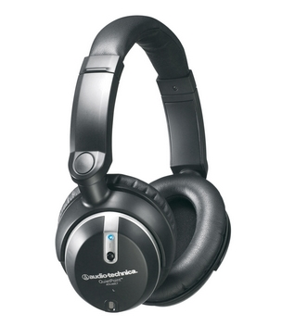

Methods for recording user actions
Paper and pencil
  Cheap, limited to writing speed
Audio
  Good for Think Aloud
Video – accurate and realistic
  Camera position to show sufficient details and user is difficult
  May ask user not to move but that is not normal behaviour
Evaluation Techniques

Slide 17
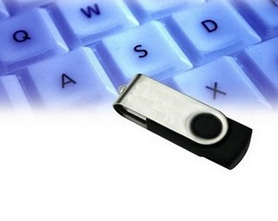

Methods for recording user actions
Computer logging – automatically done
  Large amounts of data difficult to analyze
User notebooks
  Coarse and subjective
  Good for longitudinal studies
Mixed use in practice
  Audio/video transcription with paper record of significant events
Evaluation Techniques

Slide 18
Post-Task Walkthroughs
Observational transcript (written or recorded) played back to participant for comment
Participant’s comments
Immediately  Fresh in mind
Delayed  Evaluator has time to identify questions
Necessary in cases where think aloud is not possible
Evaluation Techniques

Slide 19
Query Techniques
Interviews
Questionnaires
Evaluation Techniques

Slide 20

Interviews
Analyst questions user on one-to-one basis
  Usually based on prepared questions
  Informal, subjective and relatively cheap
Advantages
  Can be varied to suit context
  Issues can be explored more fully
Disadvantages
  Subjective and Time Consuming
Evaluation Techniques

Slide 21

Questionnaires
Set of fixed questions given to users
Quick and reaches large user group
But less flexible
Evaluation Techniques

Slide 22
Questionnaires
Need careful design
  What information is required?
  How are answers to be analyzed?
Styles of question
  General → “Establish background of user” Age, Gender, Job
  Open-ended →Can you suggest any improvement?
  Scalar→1 2 3 4 5 Is it easy to recover from mistakes?
  Multi-choice → How do you get help? Different choices
  Ranked→ Rank usefulness of methods to issue command
Evaluation Techniques

Slide 23
Questionnaires
Comprehensive?
  Test on 4-5 users before sending out
Distribution
  Respondents representative of user population
Return rate
  Very low – 25% to 30%
Evaluation Techniques

Slide 24
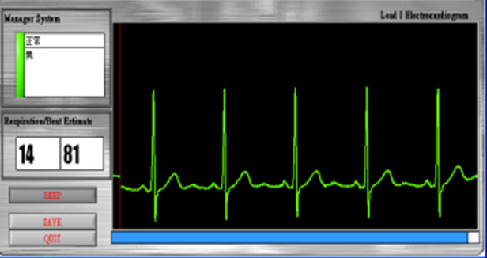
Physiological Methods
Eye Tracking
Physiological Measurements
Evaluation Techniques

Slide 25
Eye Tracking
Head or desk mounted equipment tracks the position of the eye
Eye movement reflects the amount of cognitive processing a display requires
Measurements include
  Fixations: Eye maintains stable position. Number and duration indicate level of difficulty with display
  Saccades: Rapid eye movement from one point of interest to another
Evaluation Techniques

Slide 26
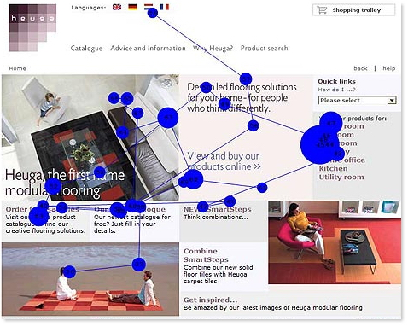
Eye Tracking

Slide 27
Physiological Measurements
These may help determine a user’s reaction to an interface
Measurements include:
  Heart activity, including blood pressure, pulse etc.
  Activity of sweat glands
  Activity in muscle
  Activity in brain
Difficulty in interpreting these physiological responses - more research needed
Evaluation Techniques

Slide 28
Choosing an Evaluation Method
Design vs. Implementation
  At what stage in design process the evaluation is required
  Evaluation of design – Should be quick and cheap
    Design Experts only
  Evaluation of Implementation
    Comprehensive – User Participation
Evaluation Techniques

Slide 29
Lab vs. Field Studies
Lab Studies
  Controlled observation losing naturalness of user environment
Field Studies
  Retain user environment but no control over activity
Combine the two
  Lab studies in early stages and field studies with implementation
Evaluation Techniques

Slide 30
Subjective vs. Objective
Subjective Methods
  Cognitive Walkthrough, Think Aloud – Rely heavily on the knowledge and interpretation of expert
  Evaluator bias – could be a problem
Objective Methods
  Controlled Experiments – Avoid bias and produce comparable results
Evaluation Techniques

Slide 31
Qualitative vs. Quantitative Measures
Related to subjectivity and objectivity
Numeric Data
  Statistical Analysis
Non-numeric Data
  Difficult to analyze
Can quantify qualitative information
  User response on a scale
Evaluation Techniques

Slide 32
Information Provided
Could be low level of high level
High level
  Is the system usable?
  Interviews
Low level
  What is the minimum font size?
  Controlled Experiments
Evaluation Techniques

Slide 33
Immediacy of Response
Think aloud
  Record user behavior at the time of interaction itself
  Measurement can alter the way user actually works
Post-Task Walkthrough
  Rely on user’s recollection of events
  Recall could be incomplete or biased
Evaluation Techniques

Slide 34
Resources
Availability of resources
  Equipment, Time, Money, Participants, Evaluators
  Video recording not possible w/o a video camera
  May not be possible to test the system in its intended environment – Space station
Evaluation Techniques

Slide 35
Go through tables at the end of Chapter 9
Image Segmentation

Slide 36

References
Chapter 9 - Human Computer Interaction by Dix et al.
Usability Engineering – Rob Miller, MIT
HCI & Interface Design – Jacek Gwidza
Interactive Design

